Slide 1
Test Driven Development
Using Mocha and Chai
with NodeJS

Slide 2
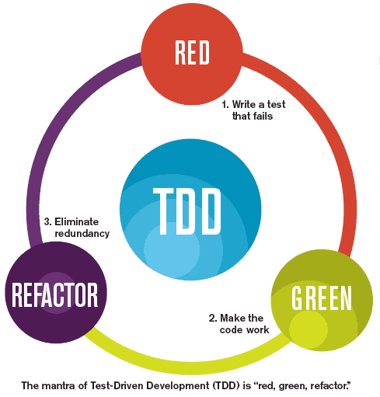
TDD in Brief
Writing Automated unit test cases for every function
This must include all both positive and negative tests at lowest levels
Tests must be written before production code
Developer’s responsibility for quality of code
TDD Workflow
RED: Write failing unit tests
GREEN: Write just enough production code to pass test
REFACTOR: Write unit test and production code to make it clean

Slide 3
Sample
#Production Code
function str_len(theStr) {
return theStr.length;
}
#Unit Test Code
it(‘returns the length of the string’, function() {
testStr = “1”; //Setup
result = str_len(testStr); //Action
expect(result).to.equal(1); //Assert
});

Slide 4
Benefits of TDD
History
Boosts confidence
Provides immediate feedback
Documents what the code does
Drives good object-oriented design
Created by Kent Beck in 1990’s
First unit testing framework was written in SmallTalk (i.e. SUnit)
First Java unit testing framework (i.e. JUnit)

Slide 5
Mocha and Chai
https://mochajs.org/
Mocha is a unit testing framework for JavaScript that works for NodeJS and JavaScript. To install Mocha:
npm install --save-dev mocha
Chai is a JavaScript assertion library that works well with Mocha and other testing frameworks. To install Chai:
npm install --save-dev chai
Run tests using the following command:
mocha tests

Slide 6
Test Suites
Used to group similar tests together
Eg.
describe(‘test_suite’, function() {
it(‘test1’, function(){
expect(result).to.equal(value);
});
…..more tests…..
}

Slide 7
Mocha Hooks
‘Before’ and ‘After’ Hooks
Before API call specifies code that executes before any test contained in a describe block
After API call specifies code that executes after any test contained in a describe block
These can be placed anywhere in the describe block
before(function() { // runs before all tests in this block });
after(function() { // runs after all tests in this block });

Slide 8
‘BeforeEach’ and ‘AfterEach’ Hooks
BeforeEach API call specifies code that executes before each test contained in a describe block
AfterEach API call specifies code that executes after each test contained in a describe block
We can specify multiple and they can be placed anywhere
beforeEach(function() { // runs before each test in this block });
afterEach(function() { // runs after each test in this block });

Slide 9
Root-level Hooks
Is an implied describe block ‘root suite’, which is outside all other test suites
Any hooks outside the describe block is included in the ‘root suite’
They will apply to all tests found in all files
For example, add beforeEach() outside of all describe() blocks.
This will cause the callback to beforeEach() to run before any test case, regardless of the file it lives in (this is because Mocha has an implied describe() block, called the "root suite").
beforeEach(function() { console.log('before every test in every file'); });

Slide 10
Assert Statements with Chai Assert Library
Truthy and Falsy
Falsy: false, 0(zero), empty string, null, undefined, NaN(not a number)
Truthy: If not Falsy
Expect and Should
Expect: Reference to your script and is passed in a value to test
Should: Called by script and adds a ‘should’ property to Object.prototype

Slide 11
Language Chains and Assertion Calls
Language Chains
to, be, been, is, that, which, has, have, with, at, of, same, but, does
Eg. expect(result).to.equal(1); expect(result).to.be.that.which.is.equal(1);
Assertion Calls
expect(result).to.equal(1); //Verifying equality
expect(result).to.be.true; //Verifying true/false
expect(result).to.be.instanceof(a); //Verifying type
expect(badFn).to.throw(); //Verifying exceptions

Slide 12
TDD Best Practices
Always do the next simplest test case
Use descriptive test names
Keep tests fast
Use code coverage tools like Istanbul (nyc)
npm install --save-dev nyc
Run test multiple times in random order
Use Static code analysis tools like JSHint

Slide 13
Code Coverage types
Istanbul (nyc)
Code coverage plugin for JavaScript in NodeJS and browser
Provides Line, Statement and Branch coverage
Can generate reports to console or in HTML format
npm install nyc
Works well with Mocha
Line
Statement
Branch
Modified condition/decision

Slide 14

https://github.com/siddhantw/TestDrivenDevelopmentForNodeJS

